Slide 1
MyMovies Video Kiosk
Movie Rental Application

Slide 2
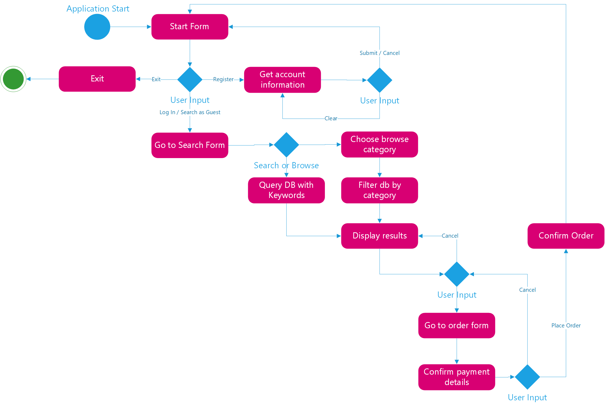
Activity Flow Diagram
Shows decisions made by users
Shows flow of control between modules

Slide 4
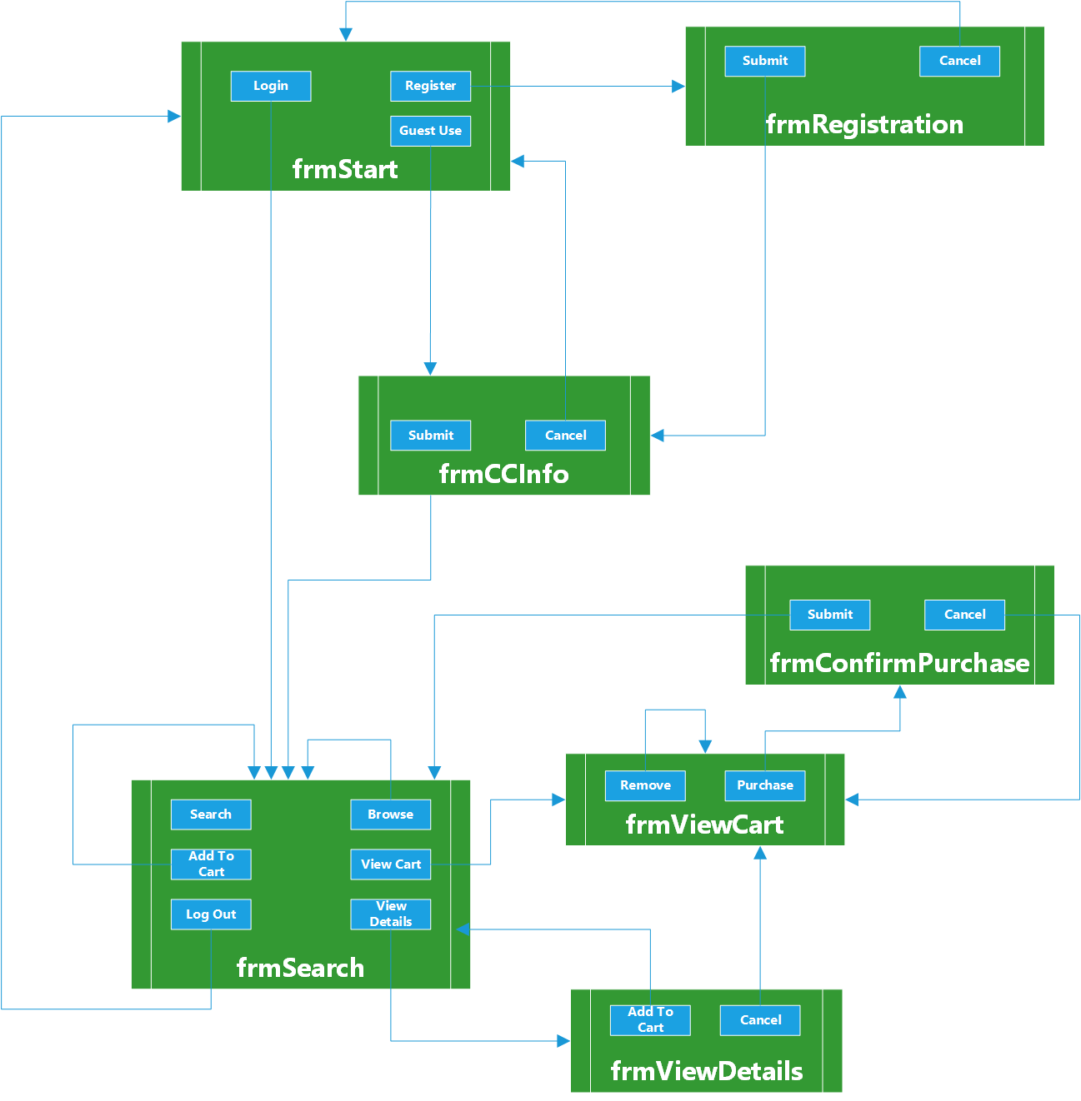
Flow Chart
Shows flow of control in application

Slide 6
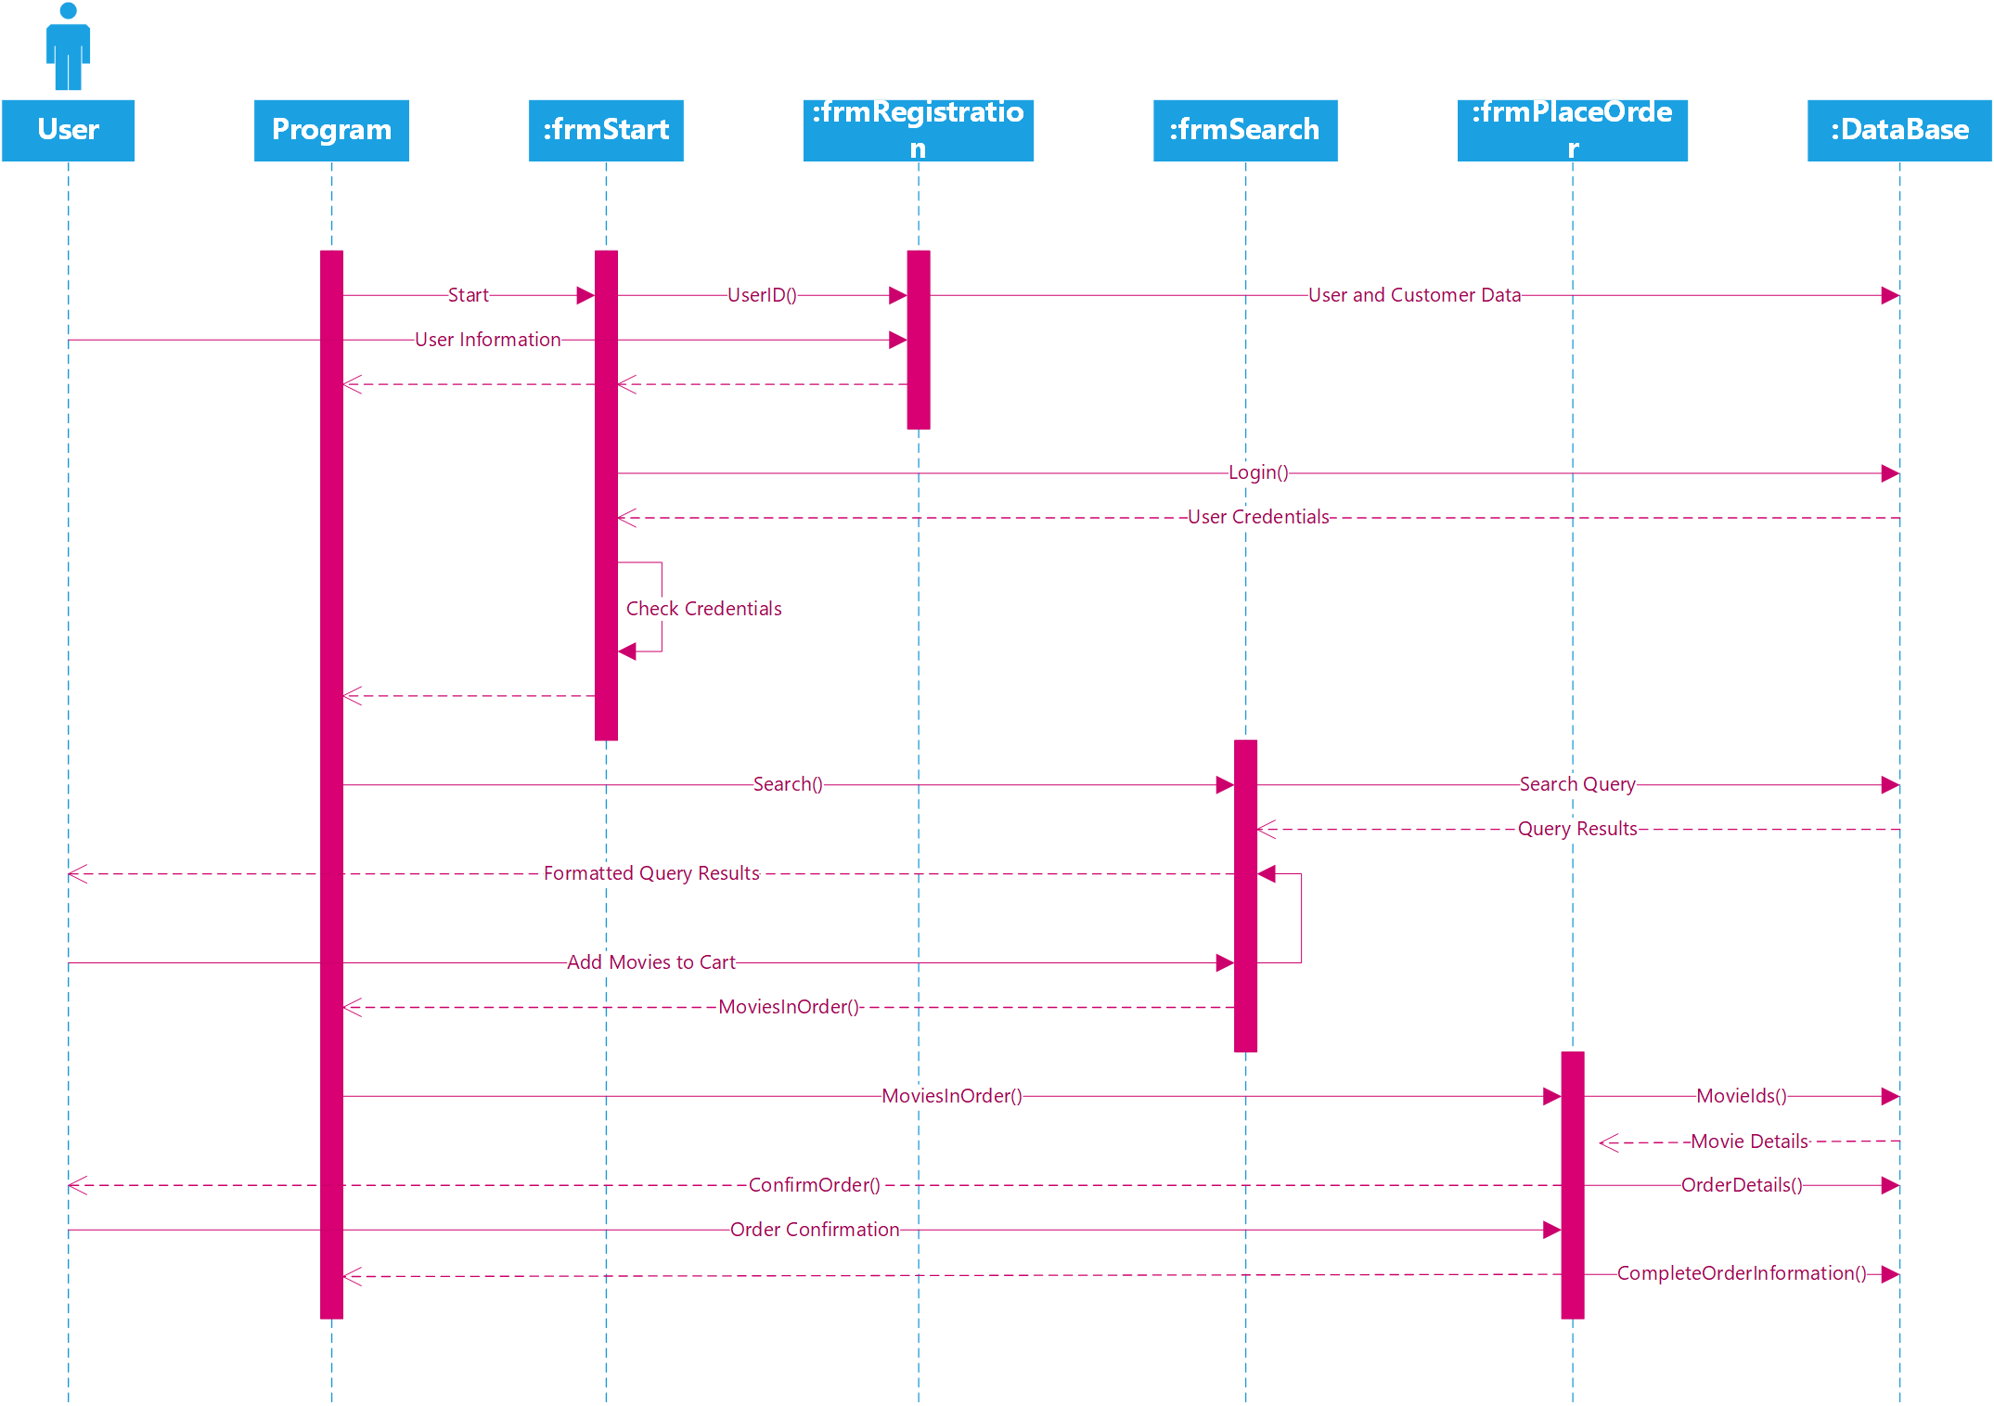
System Sequence Diagram
Shows data passed between modules

Slide 8
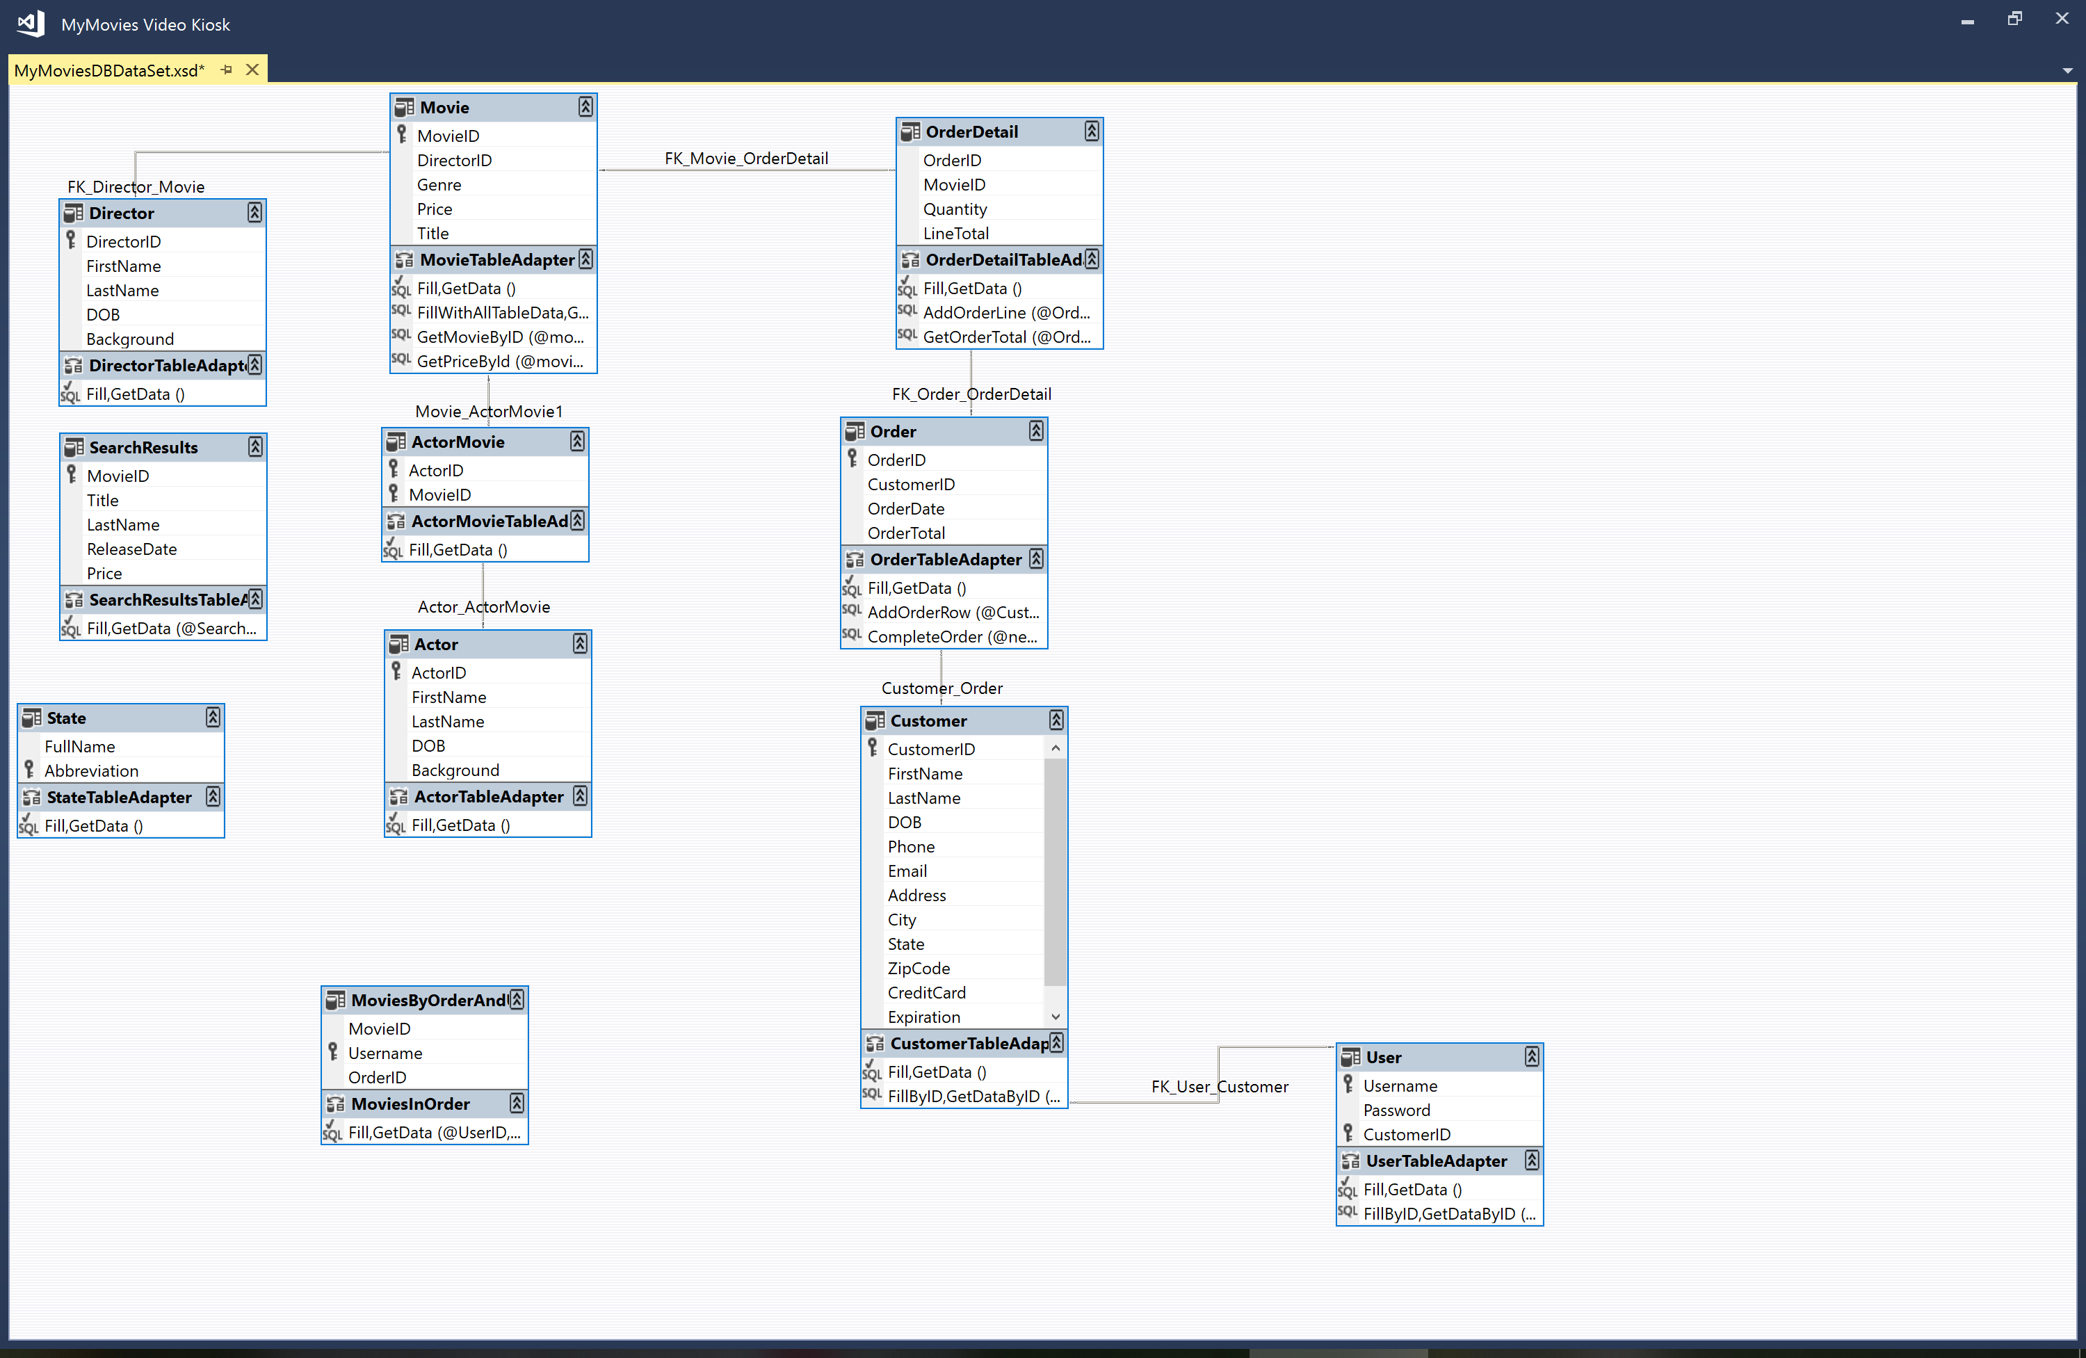
Data Set Diagram
Details contents of tables
Shows relationship between tables
Shows methods each class can perform

